Slide 1
Random Variable & Probability

Slide 2
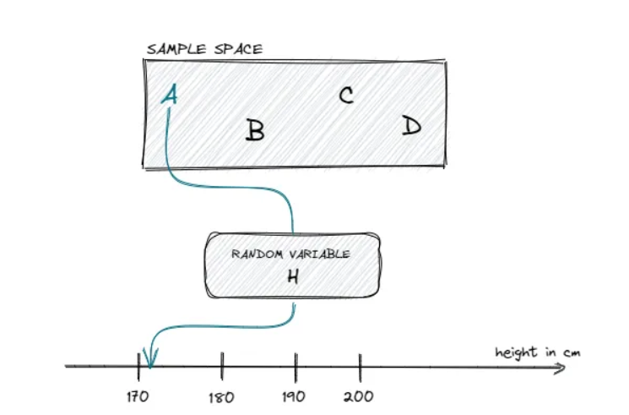
Example
`

Slide 3
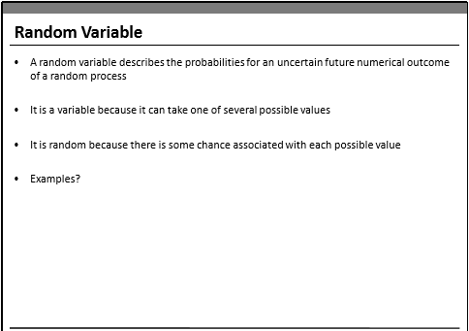

Slide 4
Discrete Random Variables : Random variables that can assume a countable number of values. If a random variable can only take a finite
number of distinct values, it must be discrete
Ex : number of defective light bulbs in a box, the number of children in a family
Continuous Random Variables: Random variables that can assume any value corresponding to any of the points contained in one or more intervals They are usually measurements. Things like heights, weights, and time are continuous random variables
Ex: time it takes to complete a race or the length of time between arrivals at a hospital clinic.

Slide 5
Z- Scores
z-score makes use of the mean and the standard deviation of the data set in order to specify the relative location of a measurement.
It represents the distance between a given data point and the mean, expressed in standard deviations. The score is also known as “standardizing” the data point
Large z-scores tell us that the measurement is larger than almost all other measurements in the data set.
Similarly, a small z-score tells us that the measurement is small than all other measurements.
If a score is 0, then the observation lies on the mean.

Slide 6
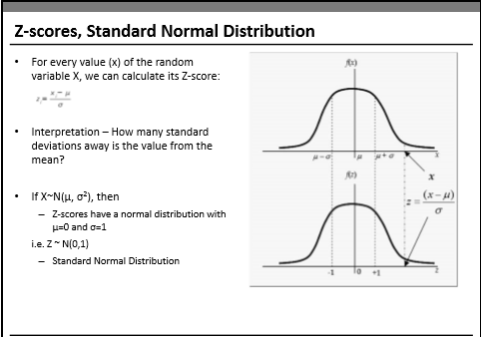
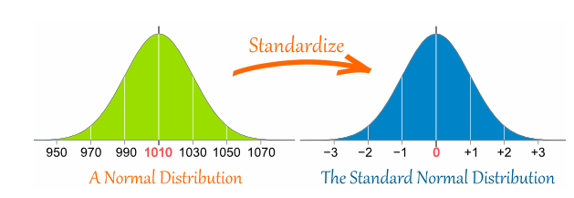

Slide 7
Probability Distributions
Continuous Probability Distributions
Discrete Probability Distribution

Slide 9
Probability Distributions
Discrete Probability Distribution: The probability distribution of a discrete random variable is a graph, table or formula that specifies the probability associated with each possible value the random variable can assume.
Discrete Probability distribution properties:
• The sum of all probabilities in a distribution sum to 1.
• Each value has a probability between 0 and 1.

Slide 10
Discrete probability Distribution:
Binomial Distribution
A binomial experiment is a statistical experiment that has the following properties:
The experiment consists of n repeated trials.
Each trial can result in just two possible outcomes. We call one of these outcomes
a success and the other, a failure ; Yes or No
The probability of success, denoted by P, is the same on every trial.
The trials are independent; that is, the outcome on one trial does not affect the
outcome on other trials.

Slide 11
Example : Binomial Distribution
Consider the following statistical experiment.
You flip a coin 2 times and count the number of times the coin lands on heads.
This is a binomial experiment because:

Slide 12
Example : Binomial Distribution
The experiment should consists of n repeated trials.
The experiment consists of repeated trials. We flip a coin 2 times.
Each trial can result in just two possible outcomes
Each trial can result in just two possible outcomes - heads or tails.
The probability of success, denoted by P, is the same on every trial
The probability of success is constant - 0.5 on every trial.
The trials are independent; that is, the outcome on one trial does not affect the
outcome on other trials.
The trials are independent; that is, getting heads on one trial does not affect whether we get heads on other trials.

Slide 13
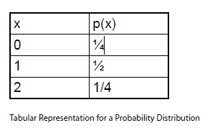
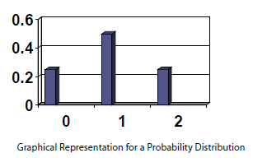
Binomial Distribution
A binomial random variable is the number of successes x in n repeated trials of a binomial experiment.
The probability distribution of a binomial random variable is called a binomial distribution
Suppose we flip a coin and count the number of heads (successes).
The binomial random variable is the number of heads,
which can take on values of 0, 1, or 2. The binomial distribution is presented below.

Slide 14
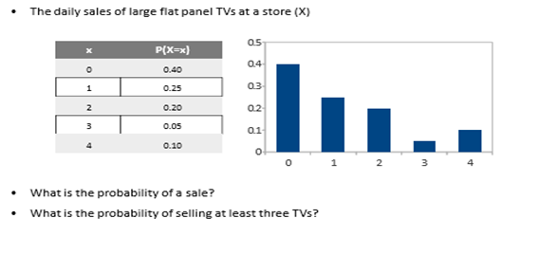
In class exercise:
Probability Calculation for discrete P.D

Slide 15
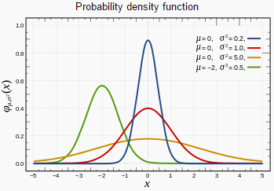
Continuous Probability Distributions
Continuous Probability Distribution: We can describe the probability distribution of a continuous random variable using a probability density function. A probability density function f(x) is a function that you can use to find the
probabilities of a continuous variable across a range of values. It tells us
what the shape of the probability distribution is.
Probability is all about how likely things are to happen, and the frequency tells you how often values occur. The higher the relative frequency, the higher the probability of that value occurring

Slide 16
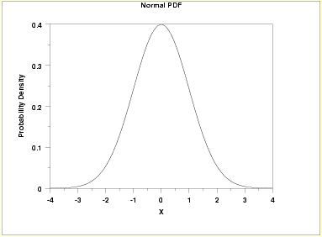
Normal Distribution
It is one of the most famous statistical distributions in use .The normal distribution is a continuous probability distribution Several phenomenon are modelled with the normal distribution.
For example : Heights of people are normally distributed as well as possible blood pressure levels for people.

Slide 17
Normal Distribution
The Properties of the Normal Distribution:
A continuous random variable X has a normal distribution if its values fall into a smooth curve that is bell shaped.
• Every normal distribution has its own mean (denoted μ) and its own standard deviation (denoted σ). The normal distribution is defined by its mean and standard deviation.
• Its shape of the normal distribution is symmetric around the mean.
• The mean, median, and the mode of a normal distribution are equal.
• The area under the curve is 1.
• Normal distributions are denser in the center and less so in the tails.
• Since the normal distribution is mound shaped, it follows the empirical rule i.e.
i) 68% of the area of a normal distribution is within one standard deviation of the mean;
ii) 95% of the data are within 2 standard deviations of the mean;
iii) 99.7% of the data are within 3 standard deviations of the mean.

Slide 18
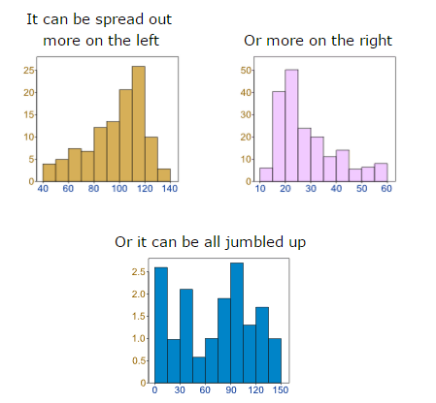
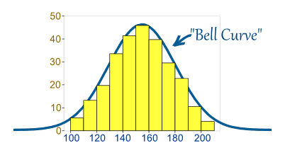
Normal Distribution
But there are many cases where the data tends to be around a central value with no bias left or right, and it gets close to a "Normal Distribution" like this
Data can be "distributed" (spread out) in different ways.
Sample(1:10000,100)

Slide 19
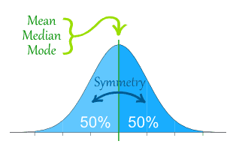
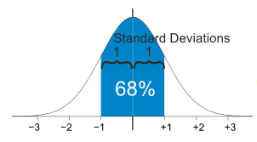
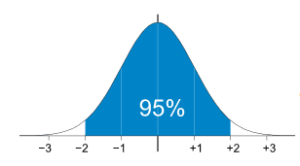
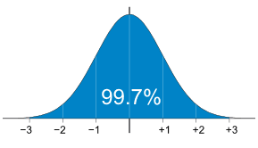
Normal Distribution
The Normal Distribution has
mean = median = mode
Symmetry about the center
50% of values less than the mean and 50% greater than the mean
95% of values are within 2 standard deviations of the mean
99.7% of values are within 3 standard deviations of the mean
68% of values are within 1 standard deviation of the mean

Slide 20
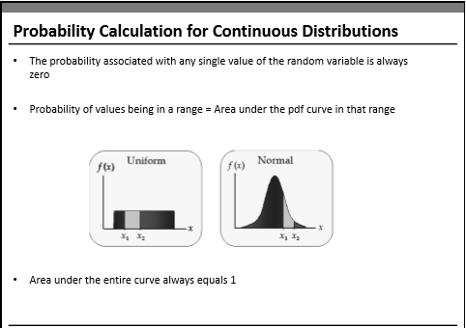


Slide 21
Probability calculation for Normal Distribution
Consider normally distributed random variable X~N(mu,sigma^2)
To compute probability P(X<=x)
from scipy import stats
stats.norm.cdf( x, loc=mean,scale=std), by def it would consider X<=32
1- stats.norm.cdf( x, loc=mean,scale=std), for greater than 32, use Area under the curve
1. X: It is the random variablel.
2. loc: It is the location parameter of the distribution. It is mean for normal distribution.
3. scale: It is the scale parameter of the distribution. It is standard deviation for normal distribution.

Slide 22
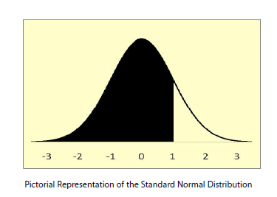
Calculating Probabilities : Normal distribution
Ex: find the probability that a normally distributed random variable has
a mean of 60 and a standard deviation of 10 and we want to find the probability that X is less than 70.
from scipy import stats
stats.norm.cdf( x, loc=mean,scale=std)

Slide 23
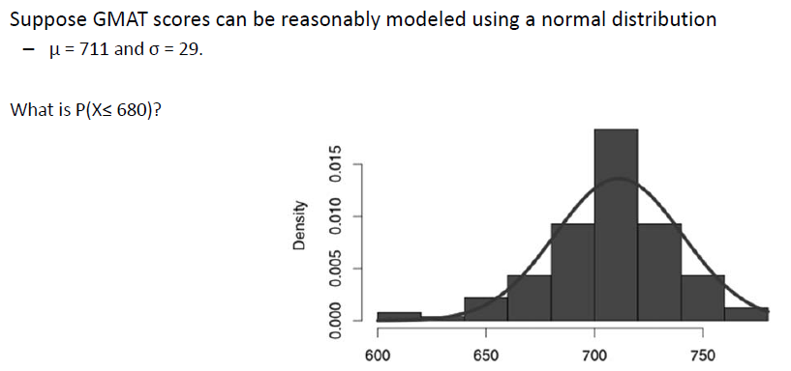
In class exercise

Slide 24
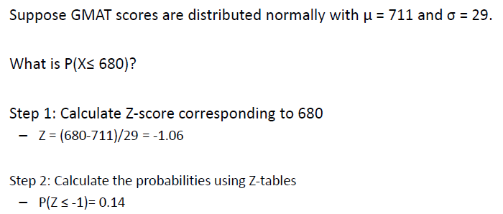
Exercise

Slide 25
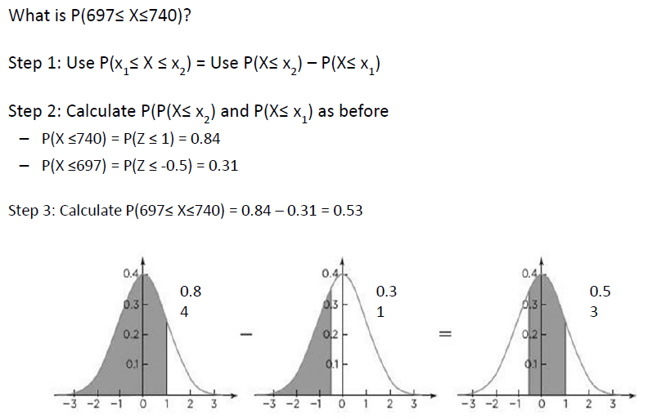
Exercise

Slide 26
Normal Distribution Example and Application

Slide 27
Stock Price
To understand normal distribution and its application, Let us use daily returns of stocks traded in BSE (Bombay Stock Exchange). Imagine a scenario where an investor wants to understand the risks and returns associated with various stocks before investing in them.
For this analysis, we will evaluate two stocks: BEML and GLAXO. The daily trading data (open and close price) for each stock is taken for the period starting from 2010 to 2016 from BSE site (www.bseindia.com)

Slide 28
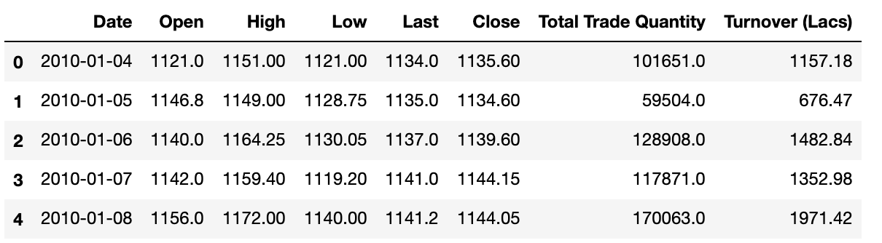
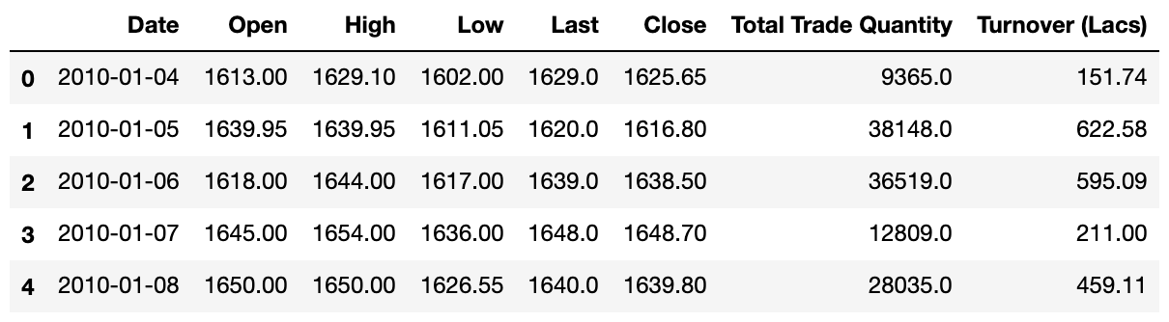
Data
BEML
The dataset contains
daily Open and Close price along with daily High and Low prices, Total Trade
Quantity, and Turnover (Lacs).
Our discussion will involve only close price. The daily returns of a stock are calculated as the change in close prices with respect to the close price of yesterday.
GLAXO

Slide 29
What questions can be answered?
1.What is the expected daily rate of return of these stocks?
2. Which stocks have higher risk or volatility as far as daily returns are concerned?
3. Which stock has higher probability of making a daily return of 2% or more?
4. Which stock has higher probability of making a loss (risk) of 2% or more?

Slide 30
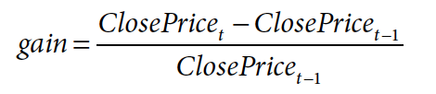
To answer the above questions, we must find out the behavior of daily returns (we will refer to this as gain hence forward) on these stocks. The gain can be calculated as a percentage change in close price, from the
previous day’s close price
The method pct_change() in Pandas will give the percentage change in a column value shifted by a period, which is passed as a parameter to periods

Slide 31
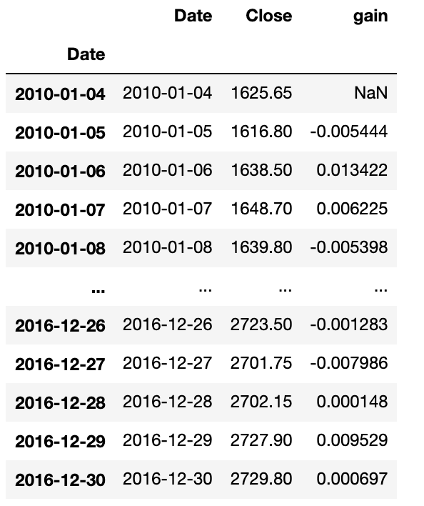
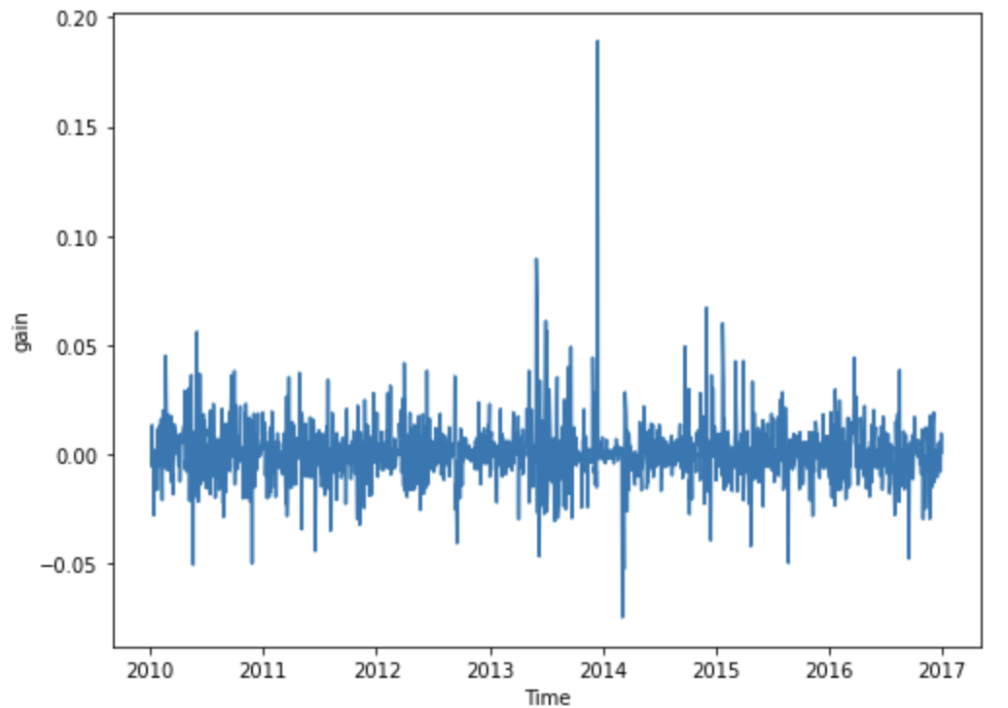

Slide 32
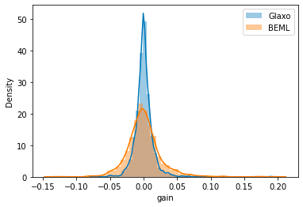
Mean and Variance
Glaxo :
Mean: 0.0004
Standard Deviation: 0.0134
BEML:
Mean: 0.0003
Standard Deviation: 0.0264
Gain seems to be normally distributed for both the stocks with a mean around 0.00.
BEML seems to have a higher variance than Glaxo
Note: This distribution has a long tail, but we will assume normal distribution for simplicity and discuss the example

Slide 33
The expected daily rate of return (gain) is around 0% for both stocks.
Here variance or standard deviation of gain indicates risk.
So, BEML stock has a higher risk as standard deviation of BEML is 2.64% whereas the standard deviation for Glaxo is 1.33%.

Slide 34
To calculate the probability of gain higher than 2% or more, we need to find out what is the sum of all probabilities that gain can take values more than 0.02 (i.e., 2%).
Probability of making
2% loss or higher in Glaxo: 0.063 or 6.3%
Probability of making
2% loss or higher in BEML: 0.2215 or 22.3%
Probability of making
2% gain or higher in Glaxo: 0.0710 or 7.1%
Probability of making
2% gain or higher in BEML: 0.2276 or 22.76%

Slide 35
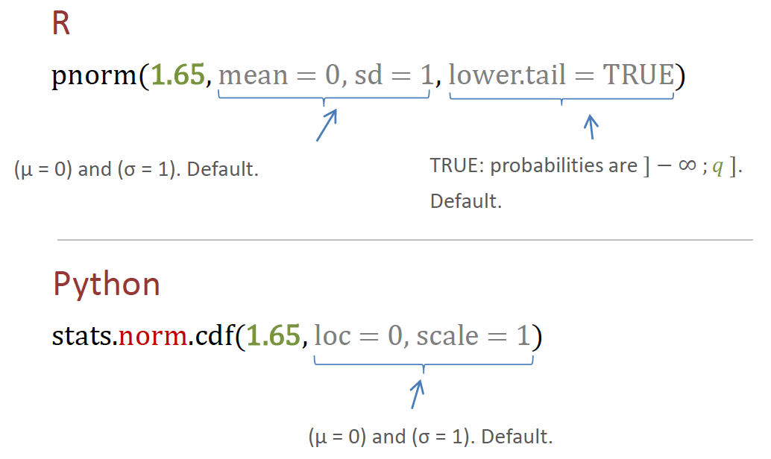
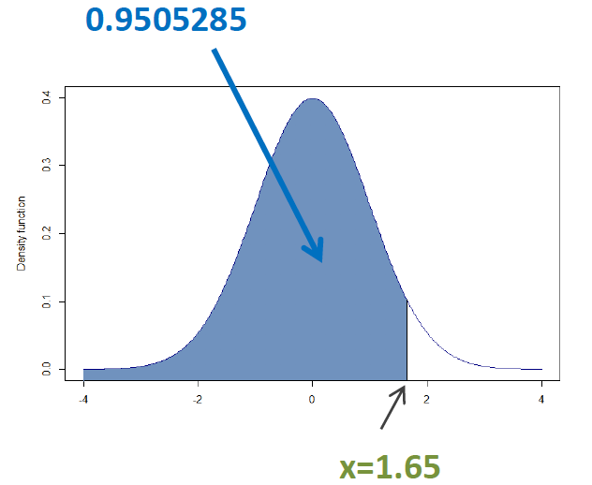
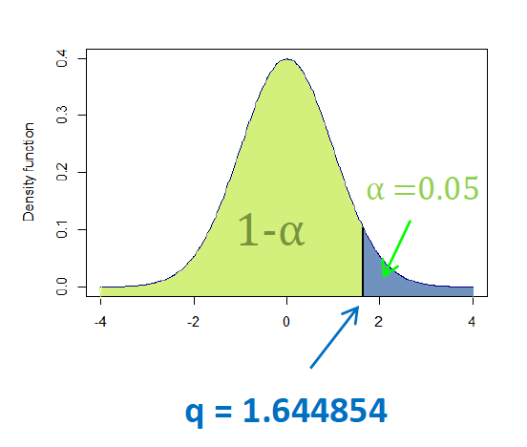
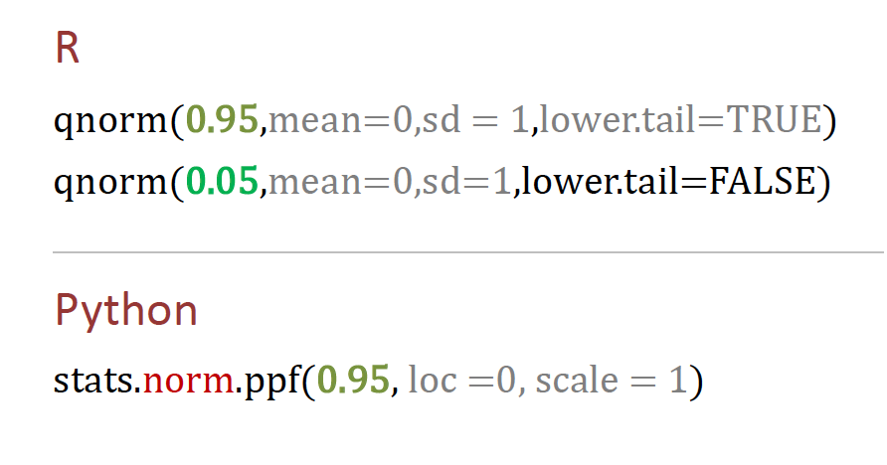
Normal Distribution codes

Slide 36
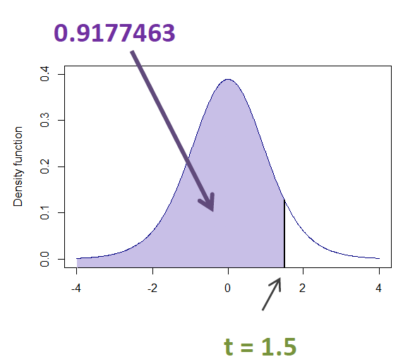
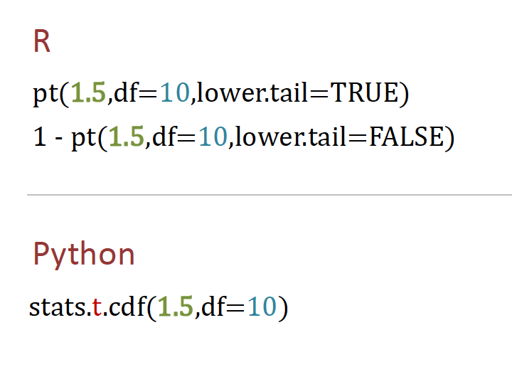
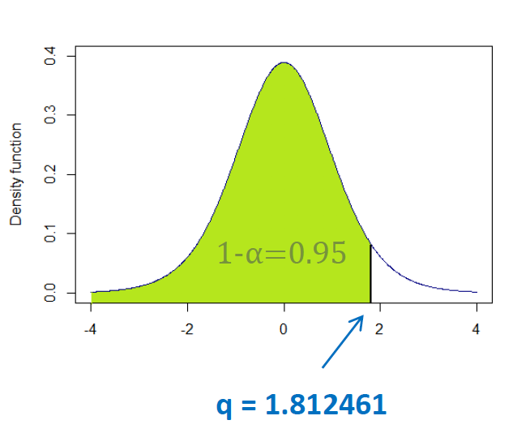
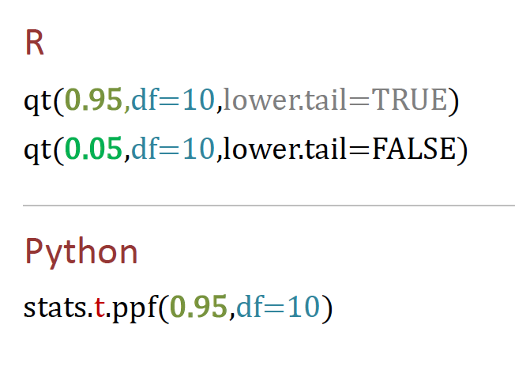
Student’ t- Distribution codes

